Slide 1
MY JOURNAL TO PYTHON
Name: 安吉琳 SID: 4110E210
MY DEAR GREAT TEACHER

Slide 2
AGENDA
Python Intro
Pyhton Syntax
Python Comments
Python Variables
Python Data Types
Python Numbers
Python Casting
Python Strings
Python Booleans
Python Operators
Python List
Python Tuples
Python Sets
Python Dictionaries
Python If..Else
Python While Loops
Python For Loops
Python Functions
Python Lambda

Slide 3
What is Python?
Python is a popular programming language. It was created by Guido van Rossum, and released in 1991.
It is used for:
web development (server-side),
software development,
mathematics,
system scripting.

Slide 4
What can Python do?
Python can be used on a server to create web applications.
Python can be used alongside software to create workflows.
Python can connect to database systems. It can also read and modify files.
Python can be used to handle big data and perform complex mathematics.
Python can be used for rapid prototyping, or for production-ready software development.

Slide 5
Why Python?
Python works on different platforms (Windows, Mac, Linux, Raspberry Pi, etc).
Python has a simple syntax similar to the English language.
Python has syntax that allows developers to write programs with fewer lines than some other programming languages.
Python runs on an interpreter system, meaning that code can be executed as soon as it is written. This means that prototyping can be very quick.
Python can be treated in a procedural way, an object-oriented way or a functional way.

Slide 6
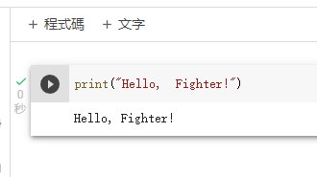
Good to know:
The most recent major version of Python is Python 3, which we shall be using in this tutorial.
However, Python 2, although not being updated with anything other than security updates, is still quite popular.
In this tutorial Python will be written in a text editor.
It is possible to write Python in an Integrated Development Environment, such as Thonny, Pycharm, Netbeans or Eclipse which are particularly useful when managing larger collections of Python files.
Example

Slide 7
Python Syntax

Slide 8
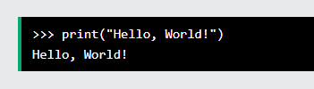

Python syntax can be executed by writing directly in the Command Line:
Or by creating a python file on the server, using the .py file extension, and running it in the Command Line:

Slide 9
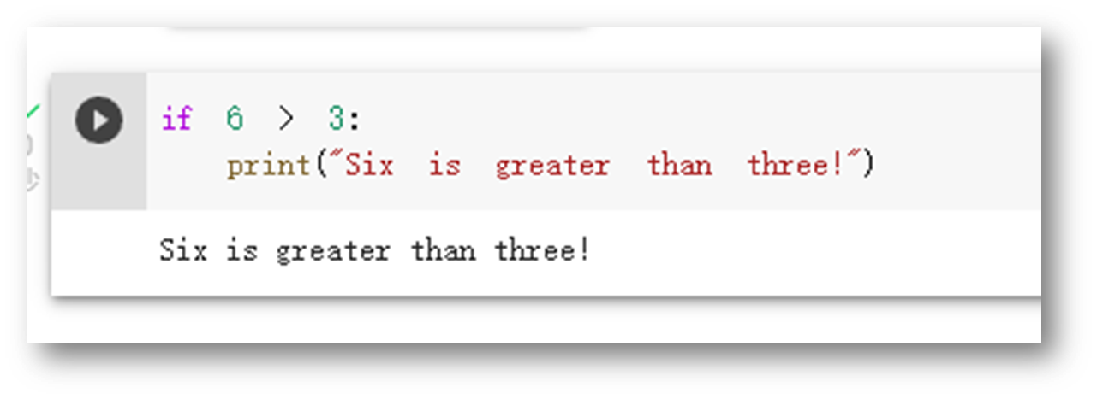
Python Indentation
Indentation refers to the spaces at the beginning of a code line.
Where in other programming languages the indentation in code is for readability only, the indentation in Python is very important.
Python uses indentation to indicate a block of code.
Python uses indentation to indicate a block of code.
Example

Slide 10
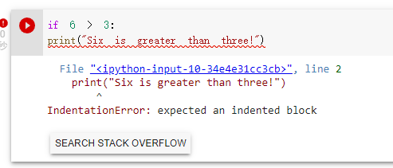
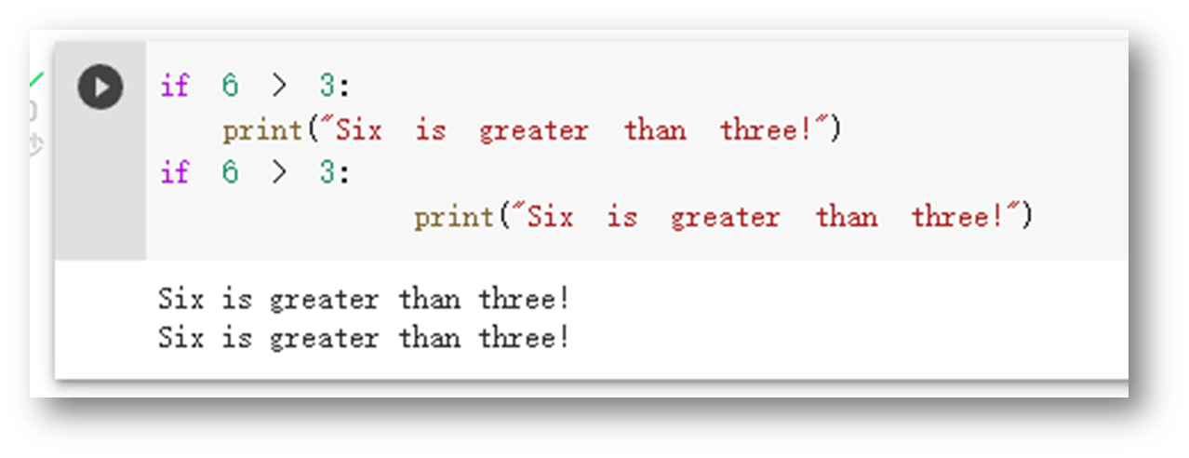
Python will give you an error if you skip the indentation:
Example
The number of spaces is up to you as a programmer, the most common use is four, but it has to be at least one.
Example

Slide 11
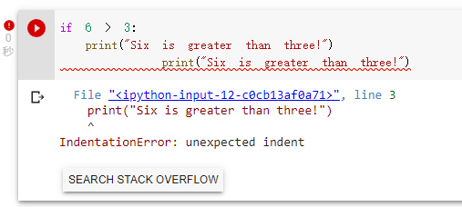
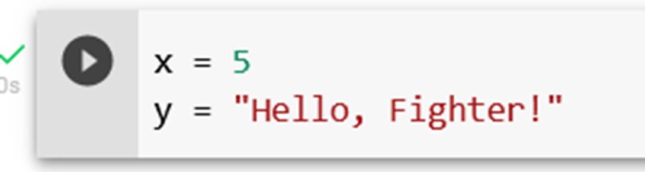
You have to use the same number of spaces in the same block of code, otherwise Python will give you an error:
In Python, variables are created when you assign a value to it:
Example

Slide 12
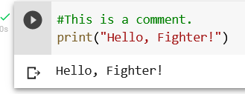
Python has no command for declaring a variable.
Comments
Python has commenting capability for the purpose of in-code documentation.
Comments start with a #, and Python will render the rest of the line as a comment:
Example

Slide 13

Python Variables
In Python, variables are created when you assign a value to it:
Example
Variables in Python:
Python has no command for declaring a variable.
You will learn more about variables in the Python Variables chapter.

Slide 14
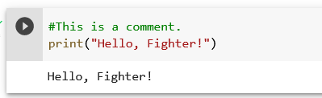
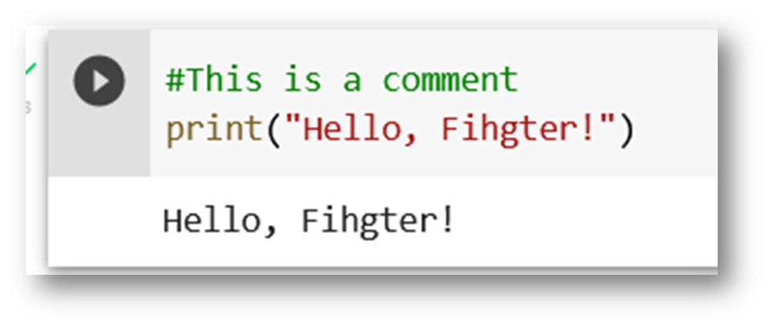
Comments
Python has commenting capability for the purpose of in-code documentation.
Comments start with a #, and Python will render the rest of the line as a comment:
Example
Comments can be used to explain Python code.
Comments can be used to make the code more readable.
Comments can be used to prevent execution when testing code.
Creating a Comment
Comments starts with a #, and Python will ignore them:

Slide 15
Python Comments

Slide 16
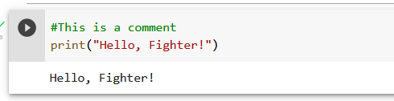
Python Comments
Comments can be used to explain Python code.
Comments can be used to make the code more readable.
Comments can be used to prevent execution when testing code.
Creating a Comment
Comments starts with a #, and Python will ignore them:

Slide 17
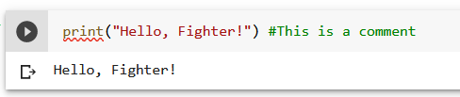
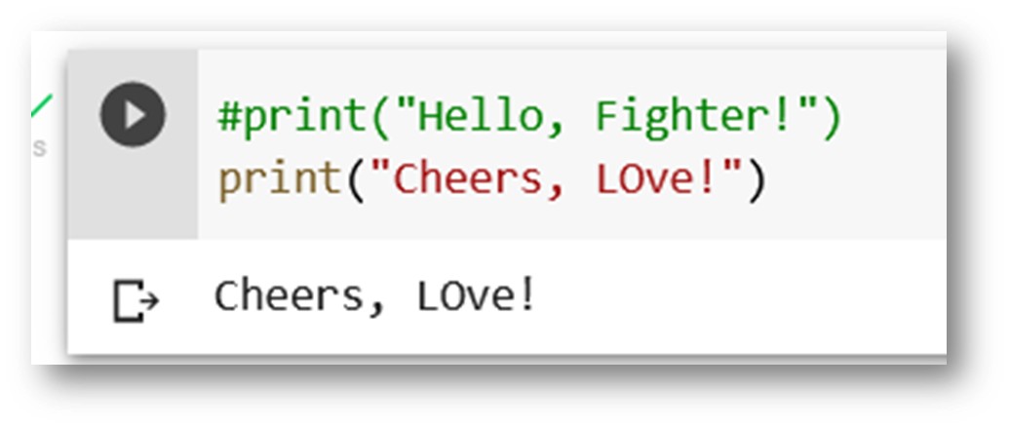
Comments can be placed at the end of a line, and Python will ignore the rest of the line:
Example
A comment does not have to be text that explains the code, it can also be used to prevent Python from executing code:

Slide 18
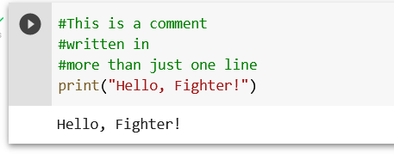
Multi Line Comments
Python does not really have a syntax for multi line comments.
To add a multiline comment you could insert a # for each line:
Example

Slide 19
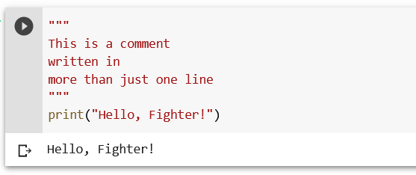
Or, not quite as intended, you can use a multiline string.
Since Python will ignore string literals that are not assigned to a variable, you can add a multiline string (triple quotes) in your code, and place your comment inside it:
Example
As long as the string is not assigned to a variable, Python will read the code, but then ignore it, and you have made a multiline comment.

Slide 20
Python Variables
Variables
Variables are containers for storing data values.

Slide 21
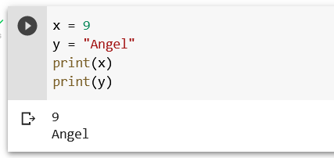
Creating Variables
Python has no command for declaring a variable.
A variable is created the moment you first assign a value to it.
Example

Slide 22
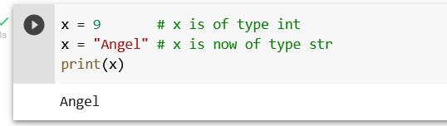
Variables do not need to be declared with any particular type, and can even change type after they have been set.
Example

Slide 23
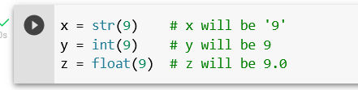
Casting
If you want to specify the data type of a variable, this can be done with casting.
Example

Slide 24
Python - Variable Names
Variable Names
A variable can have a short name (like x and y) or a more descriptive name (age, carname, total_volume). Rules for Python variables: A variable name must start with a letter or the underscore character
A variable name cannot start with a number
A variable name can only contain alpha-numeric characters and underscores (A-z, 0-9, and _ )
Variable names are case-sensitive (age, Age and AGE are three different variables)

Slide 25
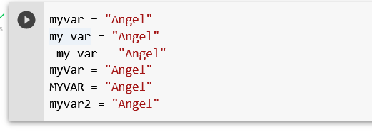
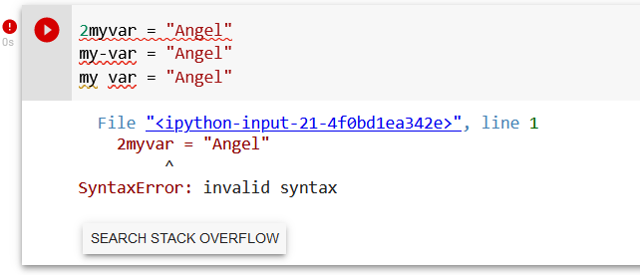
Example
Example
Illegal variable names:

Slide 26

Multi Words Variable Names
Variable names with more than one word can be difficult to read.
There are several techniques you can use to make them more readable:
Camel Case
Each word, except the first, starts with a capital letter:
Each word starts with a capital letter:

Slide 27


Pascal Case
Each word starts with a capital letter:
Snake Case
Each word is separated by an underscore character:

Slide 28
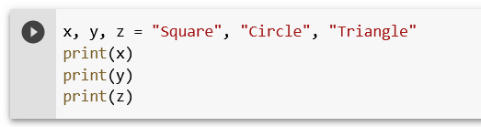
Python Variables - Assign Multiple Values
Many Values to Multiple Variables
Python allows you to assign values to multiple variables in one line:
Example

Slide 29
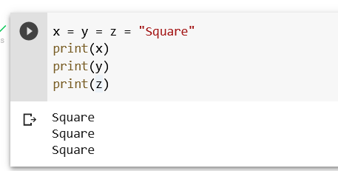
One Value to Multiple Variables
And you can assign the same value to multiple variables in one line:
Example

Slide 30
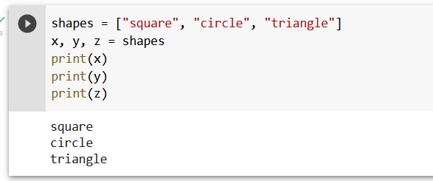
Unpack a Collection
If you have a collection of values in a list, tuple etc. Python allows you to extract the values into variables. This is called unpacking.
Example

Slide 31
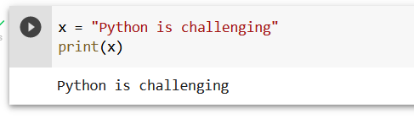
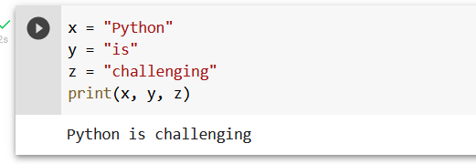
Python - Output Variables
Output Variables
The Python print() function is often used to output variables.
Example
In the print() function, you output multiple variables, separated by a comma:
Example

Slide 32
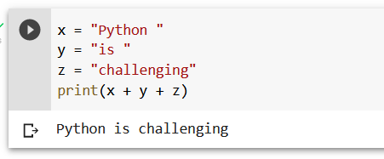
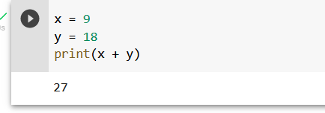
You can also use the + operator to output multiple variables:
Example
For numbers, the + character works as a mathematical operator:
Example

Slide 33
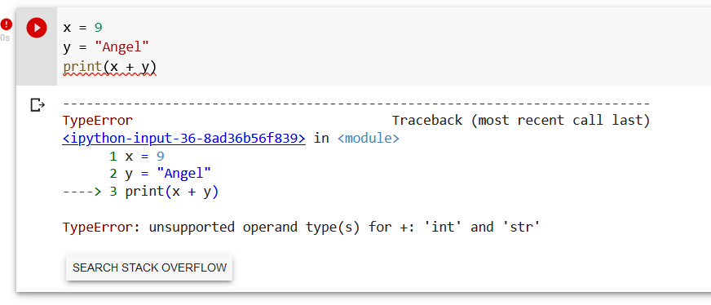
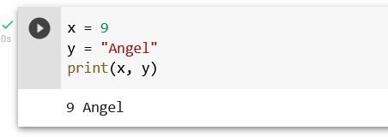
In the print() function, when you try to combine a string and a number with the + operator, Python will give you an error:
Example
The best way to output multiple variables in the print() function is to separate them with commas, which even support different data types:
Example

Slide 34
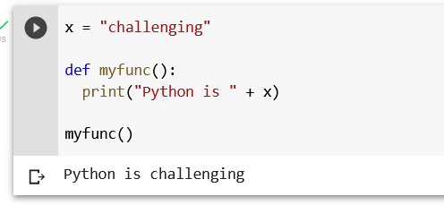
Python - Global Variables
Global Variables
Variables that are created outside of a function (as in all of the examples above) are known as global variables.
Global variables can be used by everyone, both inside of functions and outside.
Example

Slide 35
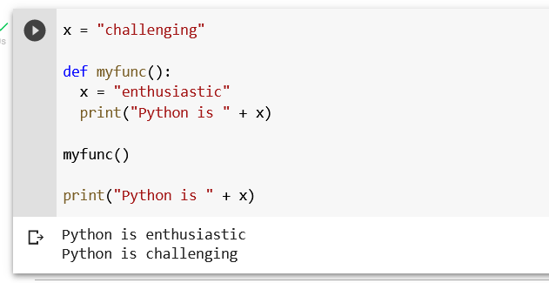
If you create a variable with the same name inside a function, this variable will be local, and can only be used inside the function. The global variable with the same name will remain as it was, global and with the original value.
Example
Create a variable inside a function, with the same name as the global variable

Slide 36
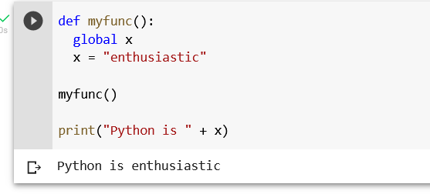
The global Keyword
Normally, when you create a variable inside a function, that variable is local, and can only be used inside that function.
To create a global variable inside a function, you can use the global keyword.
Example
If you use the global keyword, the variable belongs to the global scope:

Slide 37
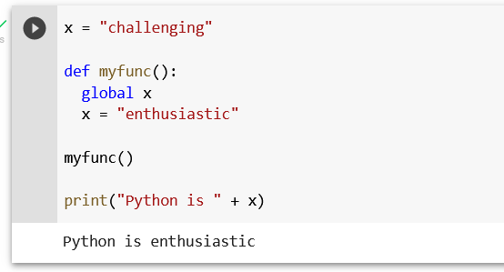
Also, use the global keyword if you want to change a global variable inside a function.
Example
To change the value of a global variable inside a function, refer to the variable by using the global keyword:

Slide 38
Python Data Types

Slide 39
Built-in Data Types
In programming, data type is an important concept.
Variables can store data of different types, and different types can do different things.

Slide 40
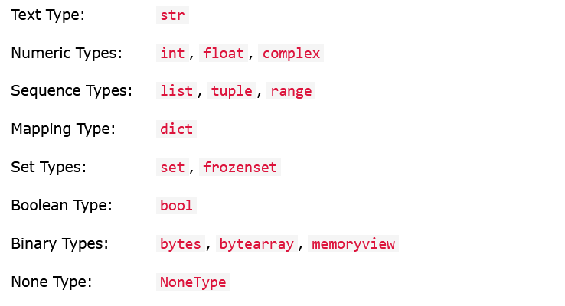
Python has the following data types built-in by default, in these categories:

Slide 41
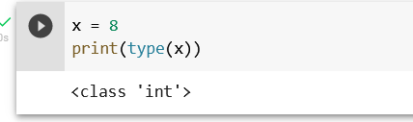
Getting the Data Type
You can get the data type of any object by using the type() function:
Example
Print the data type of the variable x:

Slide 42
Setting the Data Type

Slide 43
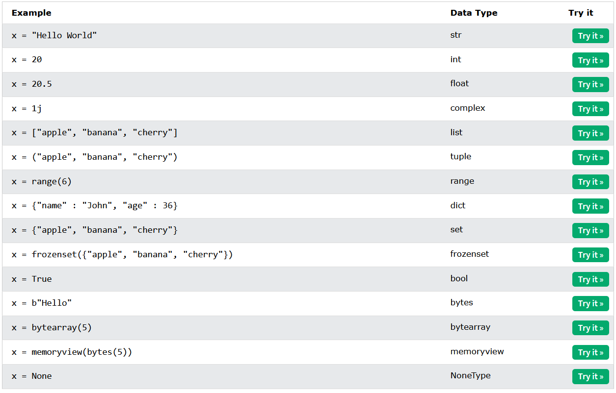
In Python, the data type is set when you assign a value to a variable:

Slide 44
Setting the Specific Data Type

Slide 45
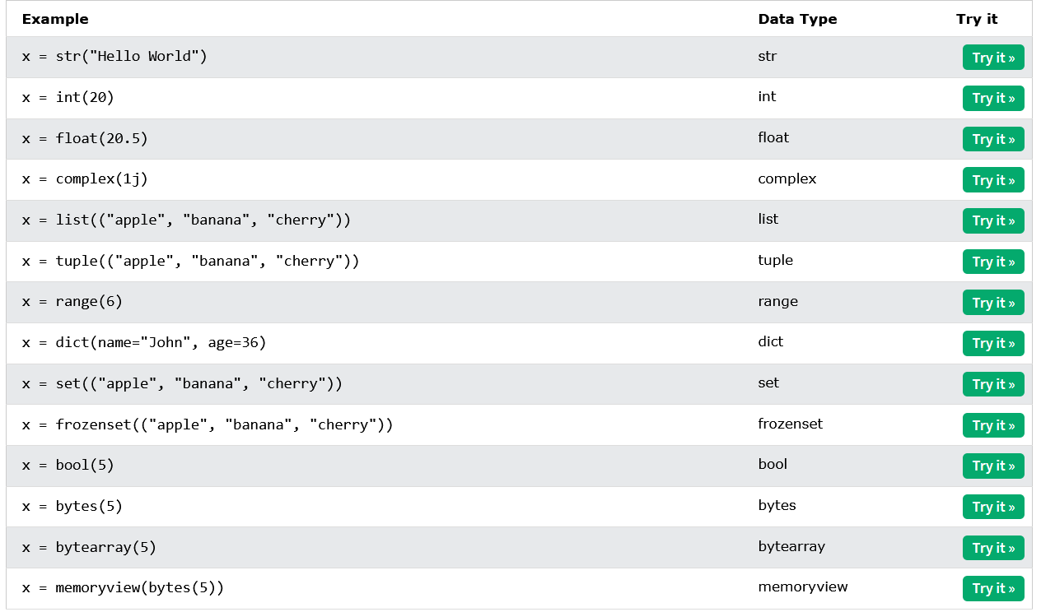
If you want to specify the data type, you can use the following constructor functions:

Slide 46
Python Numbers

Slide 47
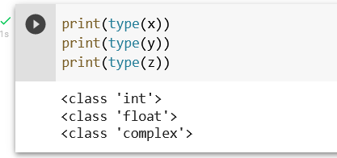
There are three numeric types in Python:
int
float
complex
Variables of numeric types are created when you assign a value to them:
x = 1 # int y = 2.8 # float z = 1j # complex
Example
To verify the type of any object in Python, use the type() function:

Slide 48
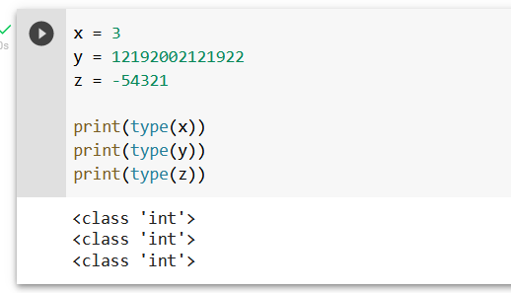
Int
Int, or integer, is a whole number, positive or negative, without decimals, of unlimited length.
Example
Integers

Slide 49
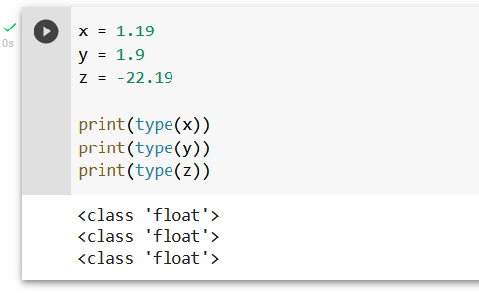
Float
Float, or "floating point number" is a number, positive or negative, containing one or more decimals.
Example

Slide 50
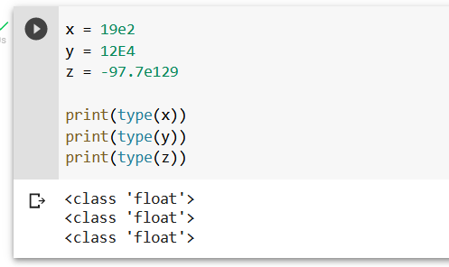
Float can also be scientific numbers with an "e" to indicate the power of 10.
Example
Floats:

Slide 51
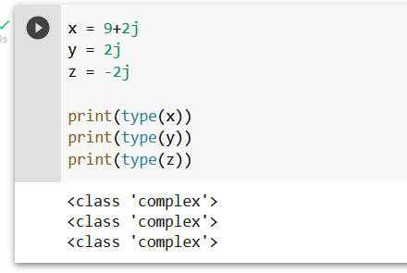
Complex
Complex numbers are written with a "j" as the imaginary part:
Example
Complex:

Slide 52
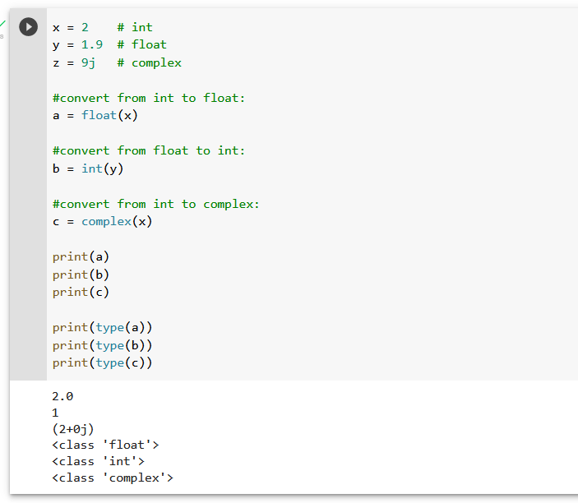
Type Conversion
You can convert from one type to another with the int(), float(), and complex() methods:
Example
Convert from one type to another:

Slide 53
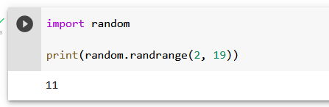
Random Number
Python does not have a random() function to make a random number, but Python has a built-in module called random that can be used to make random numbers:
Example
Import the random module, and display a random number between 1 and 9:

Slide 54
Python Casting

Slide 55
Specify a Variable Type
There may be times when you want to specify a type on to a variable. This can be done with casting. Python is an object-orientated language, and as such it uses classes to define data types, including its primitive types.
Casting in python is therefore done using constructor functions:
int() - constructs an integer number from an integer literal, a float literal (by removing all decimals), or a string literal (providing the string represents a whole number)
float() - constructs a float number from an integer literal, a float literal or a string literal (providing the string represents a float or an integer)
str() - constructs a string from a wide variety of data types, including strings, integer literals and float literals

Slide 56
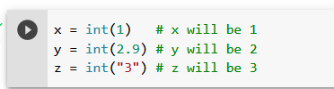
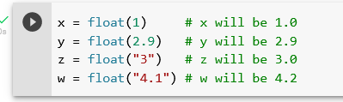
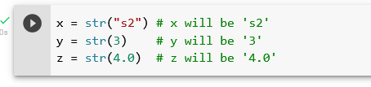
Example
Integers:
Floats:
Strings:

Slide 57
Python Strings

Slide 58
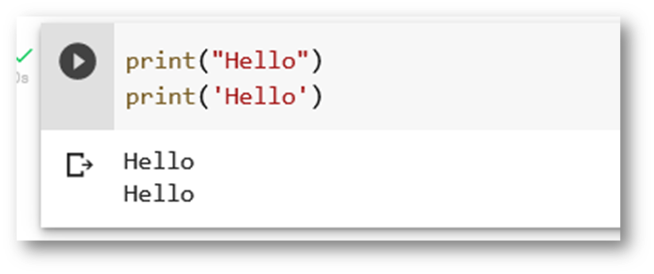
Strings
Strings in python are surrounded by either single quotation marks, or double quotation marks.
'hello' is the same as "hello".
You can display a string literal with the print() function:
Example

Slide 59
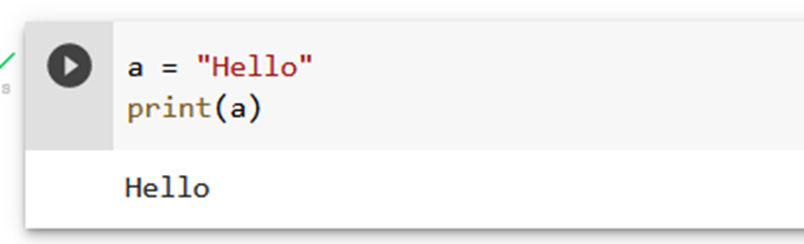
Assign String to a Variable
Assigning a string to a variable is done with the variable name followed by an equal sign and the string:
Example

Slide 60
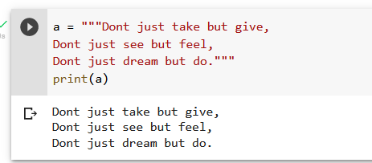
Multiline Strings
You can assign a multiline string to a variable by using three quotes:
Example
You can use three double quotes:

Slide 61

Or three single quotes:
Example

Slide 62

Strings are Arrays
Like many other popular programming languages, strings in Python are arrays of bytes representing unicode characters.
However, Python does not have a character data type, a single character is simply a string with a length of 1.
Square brackets can be used to access elements of the string.
Example
Get the character at position 1 (remember that the first character has the position 0):

Slide 63

Looping Through a String
Since strings are arrays, we can loop through the characters in a string, with a for loop.
Example
Loop through the letters in the word “square":

Slide 64

String Length
To get the length of a string, use the len() function.
Example
The len() function returns the length of a string:

Slide 65

Check String
To check if a certain phrase or character is present in a string, we can use the keyword in.
Example
Check if “love" is present in the following text:

Slide 66

Use it in an if statement:
Example
Print only if “love" is present:

Slide 67

Check if NOT
To check if a certain phrase or character is NOT present in a string, we can not in.

Slide 68

Use it in an if statement:
Example
print only if “friendship" is NOT present:

Slide 69

Python - Slicing Strings
Example
Get the characters from position 2 to position 5 (not included):

Slide 70
Slicing
You can return a range of characters by using the slice syntax.
Specify the start index and the end index, separated by a colon, to return a part of the string.

Slide 71
Slice From the Start
By leaving out the start index, the range will start at the first character:

Slide 72

Example
Get the characters from the start to position 5 (not included):

Slide 73
Slice To the End
By leaving out the end index, the range will go to the end:

Slide 74

Example
Get the characters from position 2, and all the way to the end:

Slide 75
Negative Indexing
Use negative indexes to start the slice from the end of the string:

Slide 76

Example
Get the characters:
From: “g" in “Fighter!" (position -5)
To, but not included: “r" in “Fighter!" (position -2)

Slide 77
Python - Modify Strings
Python has a set of built-in methods that you can use on strings.

Slide 78
Upper Case

Slide 79

Example
The upper() method returns the string in upper case:

Slide 80
Lower Case

Slide 81

Example
The lower() method returns the string in lower case:

Slide 82
Remove Whitespace
Whitespace is the space before and/or after the actual text, and very often you want to remove this space.

Slide 83

Example
The strip() method removes any whitespace from the beginning or the end:

Slide 84
Replace String

Slide 85

Example
The replace() method replaces a string with another string:

Slide 86
Split String
The split() method returns a list where the text between the specified separator becomes the list items.

Slide 87

Example
The split() method splits the string into substrings if it finds instances of the separator:

Slide 88
Python - String Concatenation
String Concatenation
To concatenate, or combine, two strings you can use the + operator.

Slide 89

Example
Merge variable a with variable b into variable c:

Slide 90

Example
To add a space between them, add a " ":

Slide 91
Python - Format - Strings

Slide 92
String Format

Slide 93

As we learned in the Python Variables chapter, we cannot combine strings and numbers like this:
Example

Slide 94

But we can combine strings and numbers by using the format() method!
The format() method takes the passed arguments, formats them, and places them in the string where the placeholders {} are:
Example
Use the format() method to insert numbers into strings:

Slide 95

The format() method takes unlimited number of arguments, and are placed into the respective placeholders:
Example

Slide 96

You can use index numbers {0} to be sure the arguments are placed in the correct placeholders:
Example

Slide 97
Python - Escape Characters

Slide 98
Escape Character
To insert characters that are illegal in a string, use an escape character.
An escape character is a backslash \ followed by the character you want to insert.

Slide 99

An example of an illegal character is a double quote inside a string that is surrounded by double quotes:
Example
You will get an error if you use double quotes inside a string that is surrounded by double quotes:

Slide 100
To fix this problem, use the escape character \":
Example
The escape character allows you to use double quotes when you normally would not be allowed:

Slide 101

Escape Characters
Other escape characters used in Python:

Slide 102
Python - String Methods

Slide 103
String Methods
Python has a set of built-in methods that you can use on strings.

Slide 104


Slide 105


Slide 106
Python Booleans

Slide 107
Boolean Values
In programming you often need to know if an expression is True or False.
You can evaluate any expression in Python, and get one of two answers, True or False.

Slide 108

When you compare two values, the expression is evaluated and Python returns the Boolean answer:
Example

Slide 109

When you run a condition in an if statement, Python returns True or False:
Example
Print a message based on whether the condition is True or False:

Slide 110
Evaluate Values and Variables
The bool() function allows you to evaluate any value, and give you True or False in return,

Slide 111


Example
Evaluate a string and a number:
Example
Evaluate two variables:

Slide 112
Most Values are True

Slide 113

Almost any value is evaluated to True if it has some sort of content.
Any string is True, except empty strings.
Any number is True, except 0.
Any list, tuple, set, and dictionary are True, except empty ones.
Example
The following will return True:

Slide 114
Some Values are False

Slide 115

In fact, there are not many values that evaluate to False, except empty values, such as (), [], {}, "", the number 0, and the value None. And of course the value False evaluates to False.
Example
The following will return False:

Slide 116

One more value, or object in this case, evaluates to False, and that is if you have an object that is made from a class with a __len__ function that returns 0 or False:
Example

Slide 117
Functions can Return a Boolean

Slide 118

You can create functions that returns a Boolean Value:
Example
Print the answer of a function:

Slide 119

You can execute code based on the Boolean answer of a function:
Example
Print "YES!" if the function returns True, otherwise print "NO!":

Slide 120

Python also has many built-in functions that return a boolean value, like the isinstance() function, which can be used to determine if an object is of a certain data type:
Example
Check if an object is an integer or not:

Slide 121
Python Operators

Slide 122

Operators are used to perform operations on variables and values.
In the example below, we use the + operator to add together two values:
Example
Python divides the operators in the following groups:
Arithmetic operators
Assignment operators
Comparison operators
Logical operators
Identity operators
Membership operators
Bitwise operators

Slide 123

Python Arithmetic Operators
Arithmetic operators are used with numeric values to perform common mathematical operations:

Slide 124

Python Assignment Operators
Assignment operators are used to assign values to variables:

Slide 125

Python Comparison Operators
Comparison operators are used to compare two values:

Slide 126


Python Logical Operators
Logical operators are used to combine conditional statements:
Python Identity Operators
Identity operators are used to compare the objects, not if they are equal, but if they are actually the same object, with the same memory location:

Slide 127


Python Membership Operators
Membership operators are used to test if a sequence is presented in an object:
Python Bitwise Operators
Bitwise operators are used to compare (binary) numbers:

Slide 128
Python Lists

Slide 129

List
Lists are used to store multiple items in a single variable.
Lists are one of 4 built-in data types in Python used to store collections of data, the other 3 are Tuple, Set, and Dictionary, all with different qualities and usage.
Lists are created using square brackets:
Example
Create a List:

Slide 130
List Items
List items are ordered, changeable, and allow duplicate values.
List items are indexed, the first item has index [0], the second item has index [1] etc.
Ordered
When we say that lists are ordered, it means that the items have a defined order, and that order will not change.
If you add new items to a list, the new items will be placed at the end of the list.
Note: There are some list methods that will change the order, but in general: the order of the items will not change.
Changeable
The list is changeable, meaning that we can change, add, and remove items in a list after it has been created.

Slide 131

Allow Duplicates
Since lists are indexed, lists can have items with the same value:
Example
Lists allow duplicate values:

Slide 132
Python - Access List Items

Slide 133

Access Items
List items are indexed and you can access them by referring to the index number:
Example
Print the second item of the list:

Slide 134

Negative Indexing
Negative indexing means start from the end
-1 refers to the last item, -2 refers to the second last item etc.
Example
Print the last item of the list:

Slide 135

Range of Indexes
You can specify a range of indexes by specifying where to start and where to end the range.
When specifying a range, the return value will be a new list with the specified items.
Example
Return the third, fourth, and fifth item:

Slide 136


By leaving out the start value, the range will start at the first item:
Example
This example returns the items from the beginning to, but NOT including, "kiwi":
By leaving out the end value, the range will go on to the end of the list:
Example
This example returns the items from "cherry" to the end:

Slide 137

Range of Negative Indexes
Specify negative indexes if you want to start the search from the end of the list:
Example
This example returns the items from "orange" (-4) to, but NOT including "mango" (-1):

Slide 138

Check if Item Exists
To determine if a specified item is present in a list use the in keyword:
Example
Check if "apple" is present in the list:

Slide 139
Python - Change List Items

Slide 140

Change Item Value
To change the value of a specific item, refer to the index number:
Example
Change the second item:

Slide 141

Change a Range of Item Values
To change the value of items within a specific range, define a list with the new values, and refer to the range of index numbers where you want to insert the new values:
Example
Change the values "banana" and "cherry" with the values "blackcurrant" and "watermelon":

Slide 142


If you insert more items than you replace, the new items will be inserted where you specified, and the remaining items will move accordingly:
Example
Change the second value by replacing it with two new values:
If you insert less items than you replace, the new items will be inserted where you specified, and the remaining items will move accordingly:
Example
Change the second and third value by replacing it with one value:

Slide 143

Insert Items
To insert a new list item, without replacing any of the existing values, we can use the insert() method.
The insert() method inserts an item at the specified index:
Example
Insert "watermelon" as the third item:

Slide 144
Python - Add List Items

Slide 145

Append Items
To add an item to the end of the list, use the append() method:
Example
Using the append() method to append an item:

Slide 146

Insert Items
To insert a list item at a specified index, use the insert() method.
The insert() method inserts an item at the specified index:
Example
Insert an item as the second position:

Slide 147

Extend List
To append elements from another list to the current list, use the extend() method.
Example
Add the elements of tropical to thislist:

Slide 148

Add Any Iterable
The extend() method does not have to append lists, you can add any iterable object (tuples, sets, dictionaries etc.).
Example
Add elements of a tuple to a list:

Slide 149
Python - Remove List Items

Slide 150

Remove Specified Item
The remove() method removes the specified item.
Example
Remove "banana":

Slide 151

Remove Specified Index
The pop() method removes the specified index.
Example
Remove the second item:

Slide 152

If you do not specify the index, the pop() method removes the last item.
Example
Remove the last item:

Slide 153


The del keyword also removes the specified index:
Example
Remove the first item:
The del keyword can also delete the list completely.
Example
Delete the entire list:

Slide 154

Clear the List
The clear() method empties the list.
The list still remains, but it has no content.
Example
Clear the list content:

Slide 155
Python - Loop Lists

Slide 156

Loop Through a List
You can loop through the list items by using a for loop:
Example
Print all items in the list, one by one:

Slide 157

Loop Through the Index Numbers
You can also loop through the list items by referring to their index number.
Use the range() and len() functions to create a suitable iterable.
Example
Print all items by referring to their index number:

Slide 158

Using a While Loop
You can loop through the list items by using a while loop.
Use the len() function to determine the length of the list, then start at 0 and loop your way through the list items by referring to their indexes.
Remember to increase the index by 1 after each iteration.
Example
Print all items, using a while loop to go through all the index numbers

Slide 159

Looping Using List Comprehension
List Comprehension offers the shortest syntax for looping through lists:
Example
A short hand for loop that will print all items in a list:

Slide 160
Python - List Comprehension

Slide 161

List Comprehension
List comprehension offers a shorter syntax when you want to create a new list based on the values of an existing list.
Example:
Based on a list of fruits, you want a new list, containing only the fruits with the letter "a" in the name.
Without list comprehension you will have to write a for statement with a conditional test inside:
Example

Slide 162

With list comprehension you can do all that with only one line of code:
Example
The Syntax
newlist = [expression for item in iterable if condition == True]
The return value is a new list, leaving the old list unchanged.

Slide 163


Example
Only accept items that are not “square":
The condition if x != “square" will return True for all elements other than “square", making the new list contain all shapes except “square".
The condition is optional and can be omitted:
Example
With no if statement:

Slide 164
Python - Sort Lists

Slide 165


Sort List Alphanumerically
List objects have a sort() method that will sort the list alphanumerically, ascending, by default:
Example
Sort the list alphabetically:
Example
Sort the list numerically:

Slide 166


Sort Descending
To sort descending, use the keyword argument reverse = True:
Example
Sort the list descending:
Example
Sort the list descending:

Slide 167

Customize Sort Function
You can also customize your own function by using the keyword argument key = function.
The function will return a number that will be used to sort the list (the lowest number first):
Example
Sort the list based on how close the number is to 50:

Slide 168


Case Insensitive Sort
By default the sort() method is case sensitive, resulting in all capital letters being sorted before lower case letters:
Example
Case sensitive sorting can give an unexpected result:
Luckily we can use built-in functions as key functions when sorting a list.
So if you want a case-insensitive sort function, use str.lower as a key function:
Example
Perform a case-insensitive sort of the list:

Slide 169

Reverse Order
What if you want to reverse the order of a list, regardless of the alphabet?
The reverse() method reverses the current sorting order of the elements.
Example
Reverse the order of the list items:

Slide 170
Python - Copy Lists

Slide 171


Copy a List
You cannot copy a list simply by typing list2 = list1, because: list2 will only be a reference to list1, and changes made in list1 will automatically also be made in list2.
There are ways to make a copy, one way is to use the built-in List method copy().
Example
Make a copy of a list with the copy() method:
Another way to make a copy is to use the built-in method list().
Example
Make a copy of a list with the list() method:

Slide 172
Python - Join Lists

Slide 173


Join Two Lists
There are several ways to join, or concatenate, two or more lists in Python.
One of the easiest ways are by using the + operator.
Example
Join two list:
Another way to join two lists is by appending all the items from list2 into list1, one by one:
Example
Append list2 into list1:

Slide 174

Python - List Methods
List Methods
Python has a set of built-in methods that you can use on lists.

Slide 175


Python Tuples
Tuples are used to store multiple items in a single variable.
Tuple is one of 4 built-in data types in Python used to store collections of data, the other 3 are List, Set, and Dictionary, all with different qualities and usage.
A tuple is a collection which is ordered and unchangeable.
Tuples are written with round brackets.
Example
Create a Tuple:

Slide 176

Tuple Items
Tuple items are ordered, unchangeable, and allow duplicate values.
Tuple items are indexed, the first item has index [0], the second item has index [1] etc.
Ordered
When we say that tuples are ordered, it means that the items have a defined order, and that order will not change.
Unchangeable
Tuples are unchangeable, meaning that we cannot change, add or remove items after the tuple has been created.
Allow Duplicates
Since tuples are indexed, they can have items with the same value:
Example
Tuples allow duplicate values:

Slide 177


Tuple Length
To determine how many items a tuple has, use the len() function:
Example
Print the number of items in the tuple:
Create Tuple With One Item
To create a tuple with only one item, you have to add a comma after the item, otherwise Python will not recognize it as a tuple.
Example
One item tuple, remember the comma:

Slide 178


Tuple Items - Data Types
Tuple items can be of any data type:
Example
String, int and boolean data types:
A tuple can contain different data types:
Example
A tuple with strings, integers and boolean values:

Slide 179


Python - Access Tuple Items
Access Tuple Items
You can access tuple items by referring to the index number, inside square brackets:
Example
Print the second item in the tuple:
Negative Indexing
Negative indexing means start from the end.
-1 refers to the last item, -2 refers to the second last item etc.
Example
Print the last item of the tuple:

Slide 180


Range of Indexes
You can specify a range of indexes by specifying where to start and where to end the range.
When specifying a range, the return value will be a new tuple with the specified items.
Example
Return the third, fourth, and fifth item:
By leaving out the start value, the range will start at the first item:
Example
This example returns the items from the beginning to, but NOT included, "kiwi":

Slide 181


Range of Negative Indexes
Specify negative indexes if you want to start the search from the end of the tuple:
Example
This example returns the items from index -4 (included) to index -1 (excluded)
Check if Item Exists
To determine if a specified item is present in a tuple use the in keyword:
Example
Check if "apple" is present in the tuple:

Slide 182

Python - Update Tuples
Tuples are unchangeable, meaning that you cannot change, add, or remove items once the tuple is created.
But there are some workarounds.
Change Tuple Values
Once a tuple is created, you cannot change its values. Tuples are unchangeable, or immutable as it also is called.
But there is a workaround. You can convert the tuple into a list, change the list, and convert the list back into a tuple.
Example
Convert the tuple into a list to be able to change it:

Slide 183


Add Items
Since tuples are immutable, they do not have a build-in append() method, but there are other ways to add items to a tuple.
1. Convert into a list: Just like the workaround for changing a tuple, you can convert it into a list, add your item(s), and convert it back into a tuple.
Example
Convert the tuple into a list, add "orange", and convert it back into a tuple:
2. Add tuple to a tuple. You are allowed to add tuples to tuples, so if you want to add one item, (or many), create a new tuple with the item(s), and add it to the existing tuple:
Example
Create a new tuple with the value "orange", and add that tuple:

Slide 184

Remove Items
Note: You cannot remove items in a tuple.
Tuples are unchangeable, so you cannot remove items from it, but you can use the same workaround as we used for changing and adding tuple items:
Example
Convert the tuple into a list, remove “square", and convert it back into a tuple:

Slide 185


Python - Unpack Tuples
Unpacking a Tuple
When we create a tuple, we normally assign values to it. This is called "packing" a tuple:
Example
Packing a tuple:
But, in Python, we are also allowed to extract the values back into variables. This is called "unpacking":
Example
Unpacking a tuple:

Slide 186


Python - Loop Tuples
Loop Through a Tuple
You can loop through the tuple items by using a for loop.
Example
Iterate through the items and print the values:
Loop Through the Index Numbers
You can also loop through the tuple items by referring to their index number.
Use the range() and len() functions to create a suitable iterable.
Example
Print all items by referring to their index number:

Slide 187

Using a While Loop
You can loop through the list items by using a while loop.
Use the len() function to determine the length of the tuple, then start at 0 and loop your way through the tuple items by refering to their indexes.
Remember to increase the index by 1 after each iteration.
Example
Print all items, using a while loop to go through all the index numbers:

Slide 188


Python - Join Tuples
Join Two Tuples
To join two or more tuples you can use the + operator:
Example
Join two tuples:
Multiply Tuples
If you want to multiply the content of a tuple a given number of times, you can use the * operator:
Example
Multiply the fruits tuple by 2:

Slide 189



Python - Tuple Methods
Tuple Methods
Python has two built-in methods that you can use on tuples.

Slide 190
Python Sets

Slide 191

Set
Sets are used to store multiple items in a single variable.
Set is one of 4 built-in data types in Python used to store collections of data, the other 3 are List, Tuple, and Dictionary, all with different qualities and usage.
A set is a collection which is unordered, unchangeable*, and unindexed.
Sets are written with curly brackets.
Example
Create a Set:

Slide 192

Set Items
Set items are unordered, unchangeable, and do not allow duplicate values.
Unordered
Unordered means that the items in a set do not have a defined order.
Set items can appear in a different order every time you use them, and cannot be referred to by index or key.
Unchangeable
Set items are unchangeable, meaning that we cannot change the items after the set has been created.
Duplicates Not Allowed
Sets cannot have two items with the same value.
Example
Duplicate values will be ignored:

Slide 193


Python - Access Set Items
Access Items
You cannot access items in a set by referring to an index or a key.
But you can loop through the set items using a for loop, or ask if a specified value is present in a set, by using the in keyword.
Example
Loop through the set, and print the values:
Example
Check if “square" is present in the set:

Slide 194
Python Dictionaries

Slide 195

Dictionary
Dictionaries are used to store data values in key:value pairs.
A dictionary is a collection which is ordered*, changeable and do not allow duplicates.
Dictionaries are written with curly brackets, and have keys and values:
Example
Create and print a dictionary:

Slide 196

Dictionary Items
Dictionary items are ordered, changeable, and does not allow duplicates.
Dictionary items are presented in key:value pairs, and can be referred to by using the key name.
Example
Print the "brand" value of the dictionary:
Changeable
Dictionaries are changeable, meaning that we can change, add or remove items after the dictionary has been created.

Slide 197


Duplicates Not Allowed
Dictionaries cannot have two items with the same key:
Example
Duplicate values will overwrite existing values:
Dictionary Length
To determine how many items a dictionary has, use the len() function:
Example
Print the number of items in the dictionary:

Slide 198


Dictionary Items - Data Types
The values in dictionary items can be of any data type:
Example
String, int, boolean, and list data types:
type()
From Python's perspective, dictionaries are defined as objects with the data type 'dict':
<class 'dict'>
Example
Print the data type of a dictionary:

Slide 199
Python If ... Else

Slide 200

Python Conditions and If statements
Python supports the usual logical conditions from mathematics:
Equals: a == b
Not Equals: a != b
Less than: a < b
Less than or equal to: a <= b
Greater than: a > b
Greater than or equal to: a >= b
These conditions can be used in several ways, most commonly in "if statements" and loops.
An "if statement" is written by using the if keyword.
Example
If statement:

Slide 201


Indentation
Python relies on indentation (whitespace at the beginning of a line) to define scope in the code. Other programming languages often use curly-brackets for this purpose.
Example
If statement, without indentation (will raise an error):
Elif
The elif keyword is pythons way of saying "if the previous conditions were not true, then try this condition".
Example

Slide 202


Else
The else keyword catches anything which isn't caught by the preceding conditions.
Example
In this example a is greater than b, so the first condition is not true, also the elif condition is not true, so we go to the else condition and print to screen that "a is greater than b".
You can also have an else without the elif:

Slide 203


Short Hand If
If you have only one statement to execute, you can put it on the same line as the if statement.
Example
One line if statement:
Short Hand If ... Else
If you have only one statement to execute, one for if, and one for else, you can put it all on the same line:
Example
One line if else statement:

Slide 204


Example
One line if else statement, with 3 conditions:
And
The and keyword is a logical operator, and is used to combine conditional statements:
Example
Test if a is greater than b, AND if c is greater than a:

Slide 205


Or
The or keyword is a logical operator, and is used to combine conditional statements:
Example
Test if a is greater than b, OR if a is greater than c:
Nested If
You can have if statements inside if statements, this is called nested if statements.
Example

Slide 206

The pass Statement
if statements cannot be empty, but if you for some reason have an if statement with no content, put in the pass statement to avoid getting an error.

Slide 207
Python While Loops

Slide 208

Python Loops
Python has two primitive loop commands:
while loops
for loops
The while Loop
With the while loop we can execute a set of statements as long as a condition is true.
Example
Print i as long as i is less than 6:

Slide 209


The break Statement
With the break statement we can stop the loop even if the while condition is true:
Example
Exit the loop when i is 3:
i = 1
The continue Statement
With the continue statement we can stop the current iteration, and continue with the next:
Example
Continue to the next iteration if i is 3:

Slide 210
Python For Loops

Slide 211

Python For Loops
A for loop is used for iterating over a sequence (that is either a list, a tuple, a dictionary, a set, or a string).
This is less like the for keyword in other programming languages, and works more like an iterator method as found in other object-orientated programming languages.
With the for loop we can execute a set of statements, once for each item in a list, tuple, set etc.
Example
Print each fruit in a shapes list:

Slide 212


Looping Through a String
Even strings are iterable objects, they contain a sequence of characters:
Example
Loop through the letters in the word “square":
The break Statement
With the break statement we can stop the loop before it has looped through all the items:
Example
Exit the loop when x is "banana":

Slide 213
Python Functions

Slide 214


A function is a block of code which only runs when it is called.
You can pass data, known as parameters, into a function.
A function can return data as a result.
Creating a Function
In Python a function is defined using the def keyword:
Example
Calling a Function
To call a function, use the function name followed by parenthesis:
Example

Slide 215

Arguments
Information can be passed into functions as arguments.
Arguments are specified after the function name, inside the parentheses. You can add as many arguments as you want, just separate them with a comma.
The following example has a function with one argument (fname). When the function is called, we pass along a first name, which is used inside the function to print the full name:
Example

Slide 216


Number of Arguments
By default, a function must be called with the correct number of arguments. Meaning that if your function expects 2 arguments, you have to call the function with 2 arguments, not more, and not less.
Example
This function expects 2 arguments, and gets 2 arguments:
Arbitrary Arguments, *args
If you do not know how many arguments that will be passed into your function, add a * before the parameter name in the function definition.
This way the function will receive a tuple of arguments, and can access the items accordingly:
Example
If the number of arguments is unknown, add a * before the parameter name:

Slide 217
Python Lambda

Slide 218


A lambda function is a small anonymous function.
A lambda function can take any number of arguments, but can only have one expression.
Syntax
lambda arguments : expression
The expression is executed and the result is returned:
Example
Add 10 to argument a, and return the result:
Lambda functions can take any number of arguments:
Example
Multiply argument a with argument b and return the result:

